Slide 1

Merge Sort (Analysis)
Introduction
Design and Analysis of Algorithms I

Slide 2
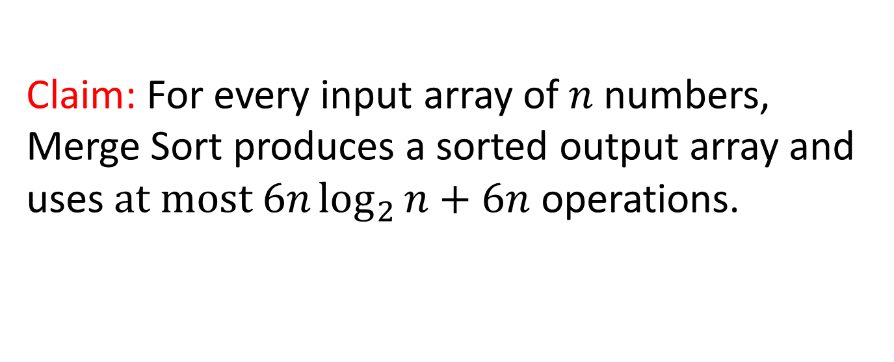
Running Time of Merge Sort
Claim: For every input array of $n$ numbers, Merge Sort produces a sorted output array and uses $at most 6n\log_{2}{n+6n}$ operations.

Slide 3
Proof of claim (assuming n = power of 2):

Slide 4
Roughly how many levels does this recursion tree have (as a function of n, the length of the input array)?
A constant number (independent of n).
$$\log_{2}{n}$$
$$\sqrt{n}$$
$$n$$

Slide 5
Proof of claim (assuming n = power of 2):

Slide 6
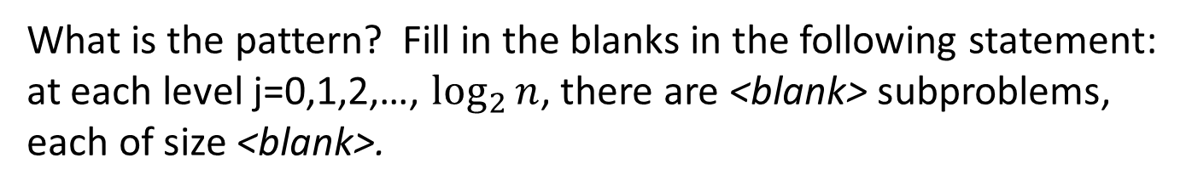
What is the pattern? Fill in the blanks in the following statement: at each level j=0,1,2,…, $\log_{2}{n}$, there are <blank> subproblems, each of size <blank>.
2^{j} and 2^{j}, respectively.
$$\text{n}\text{/2}\text{j} \text{and} \text{n}\text{/2}\text{j}\text{, }\text{respectively}\text{.}$$
$$\text{2}\text{j} \text{and} \text{n}\text{/2}\text{j}\text{, }\text{respectively}\text{.}$$
$$\text{n}\text{/2}\text{j} \text{and}\text{ 2}\text{j}\text{, }\text{respectively}\text{.}$$

Slide 7

Proof of claim (assuming n = power of 2):
At each level j=0,1,2,…, $\log_{2}{n}$, there are 2^{j} subproblems, each of size n/2^{j}.

Slide 8
Running Time of Merge Sort
Claim: For every input array of $n$ numbers, Merge Sort produces a sorted output array and uses $at most 6n\log_{2}{n+6n}$ operations.

